Slide 1

GeneTonic
Enjoying the interpretation of your RNA-seq data analysis
R in Pharma, November 2-4
Annekathrin Ludt and Federico Marini
@AnnekathrinLudt @FedeBioinfo

Slide 2
Transcriptome analysis 101
RNA-seq: High dimensional snapshot to quantify the transcriptomic activity of all RNA species in a sample
Data: genes x samples (e.g. bulk/single cells)
Objectives:
Compare abundances to discover differentially expressed genes, gene signatures, etc. - features associated with phenotypic differences
Identification of cell subpopulations, description of developmental trajectories, study noise and heterogeneity in transcriptional regulation
A wide variety of applications exist...

Slide 3
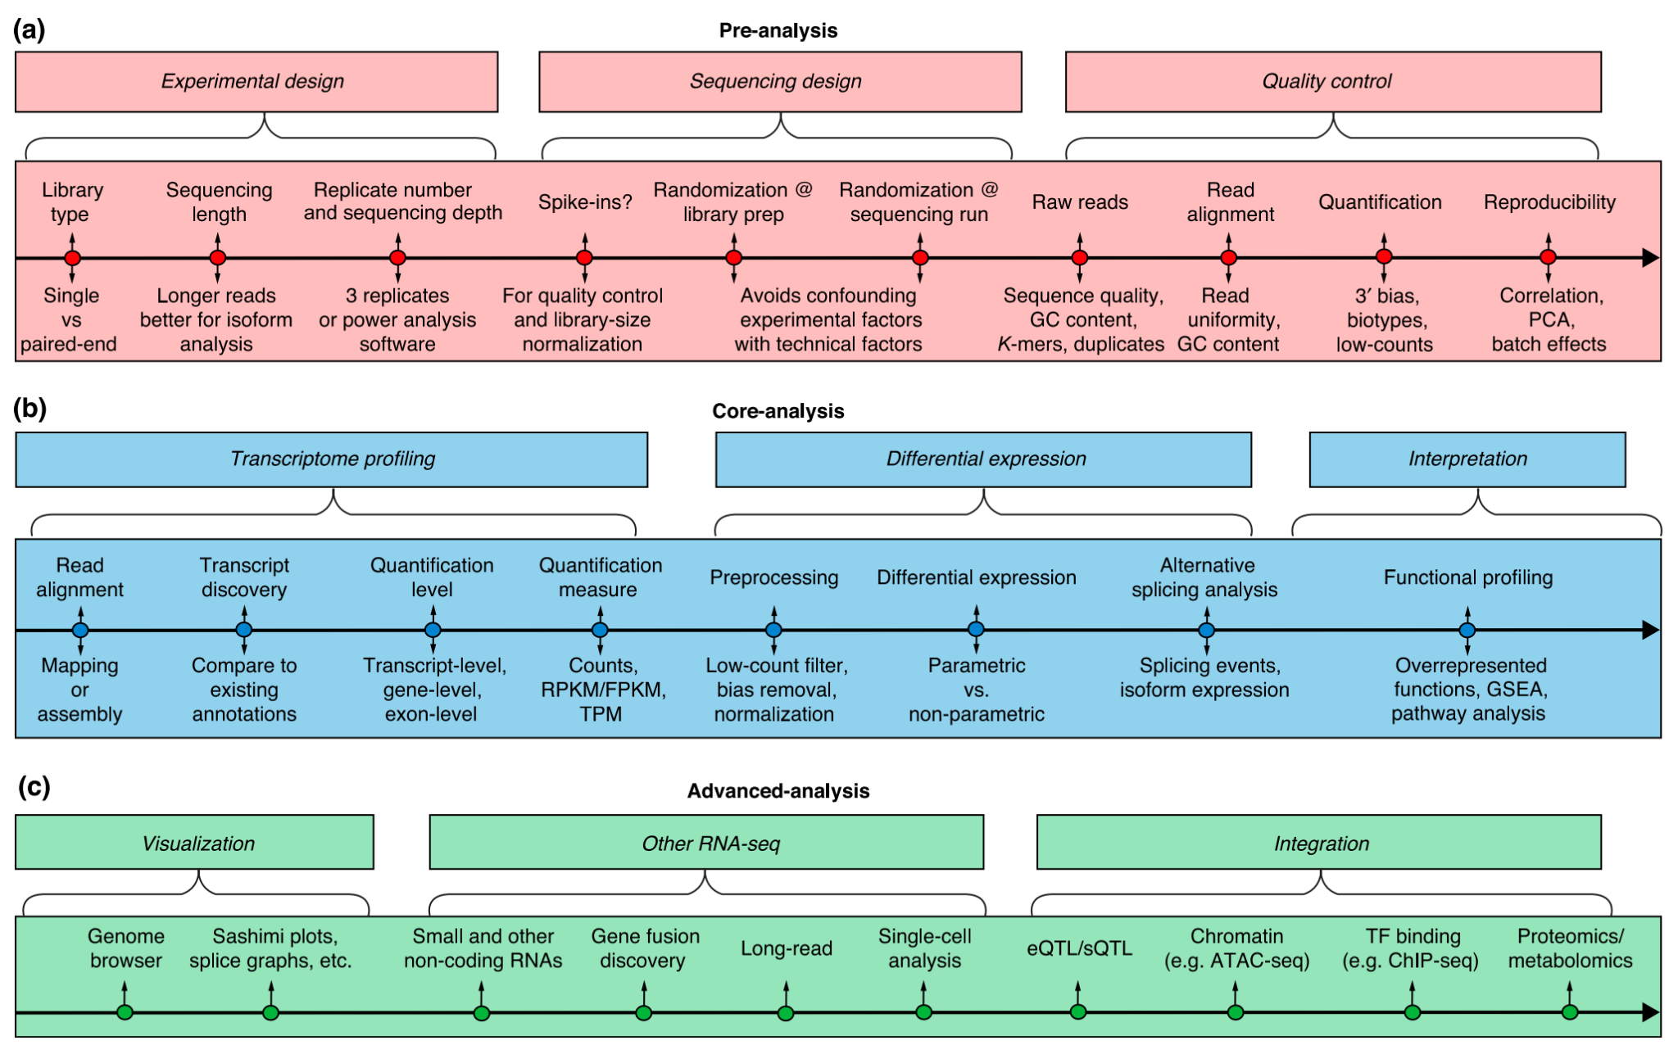
RNA-seq: DE analysis can be easy
https://doi.org/10.1186/s13059-016-0881-8

Slide 4

The real bottleneck to spark joy in the analysis...

Slide 5



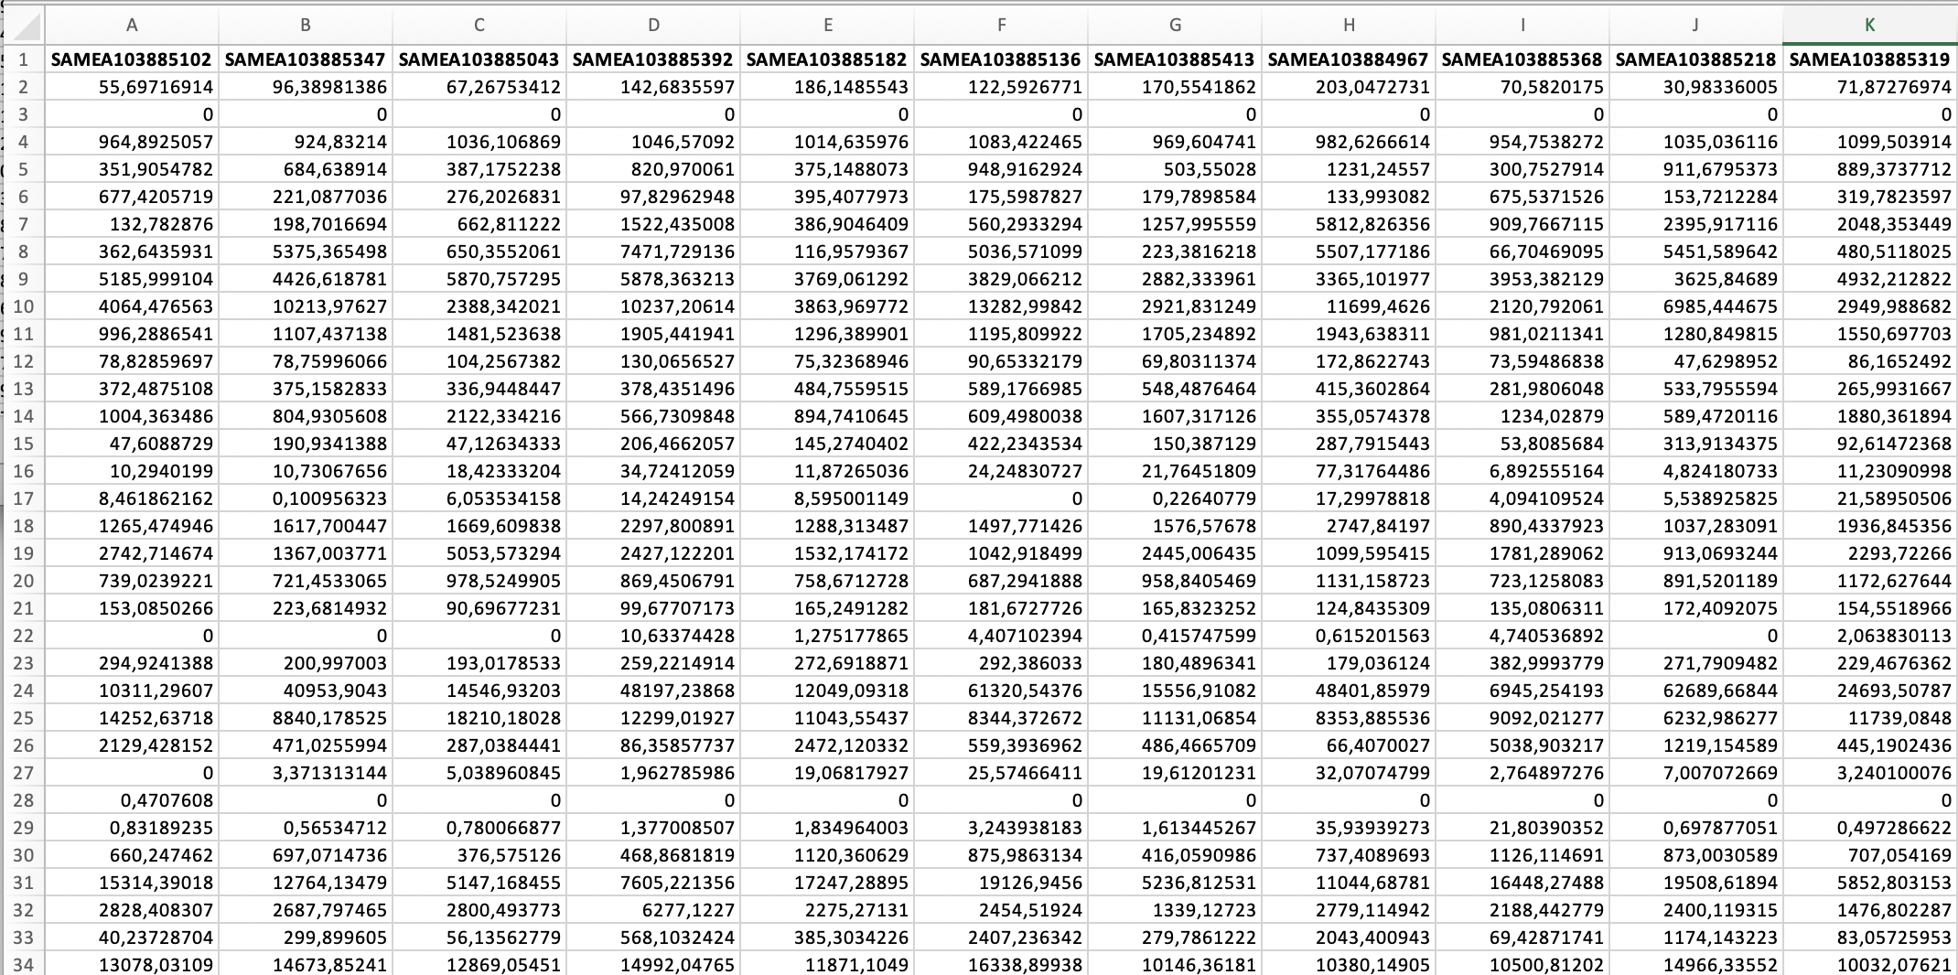
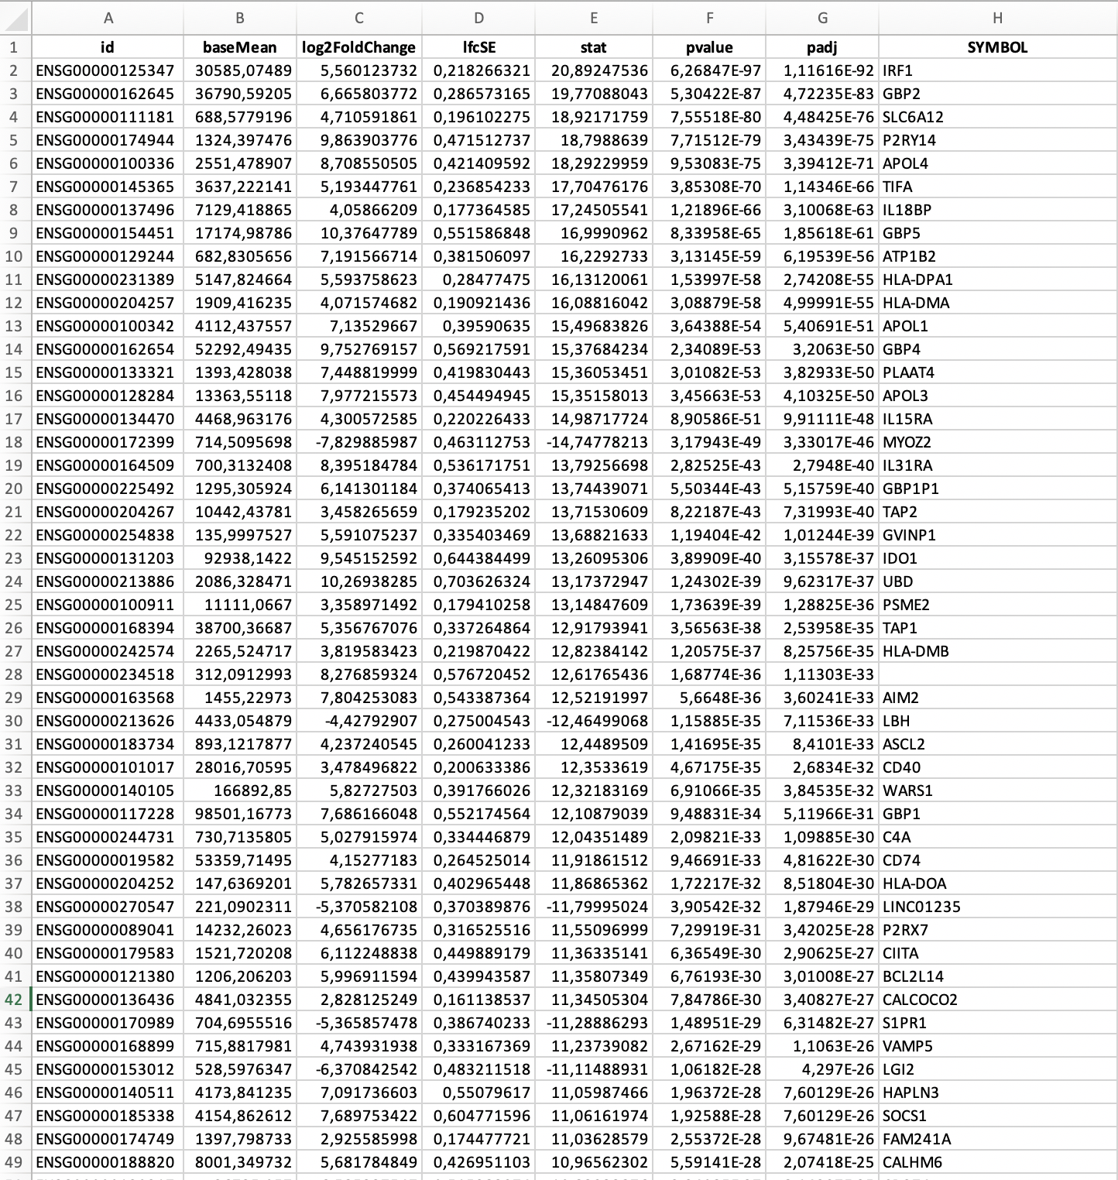
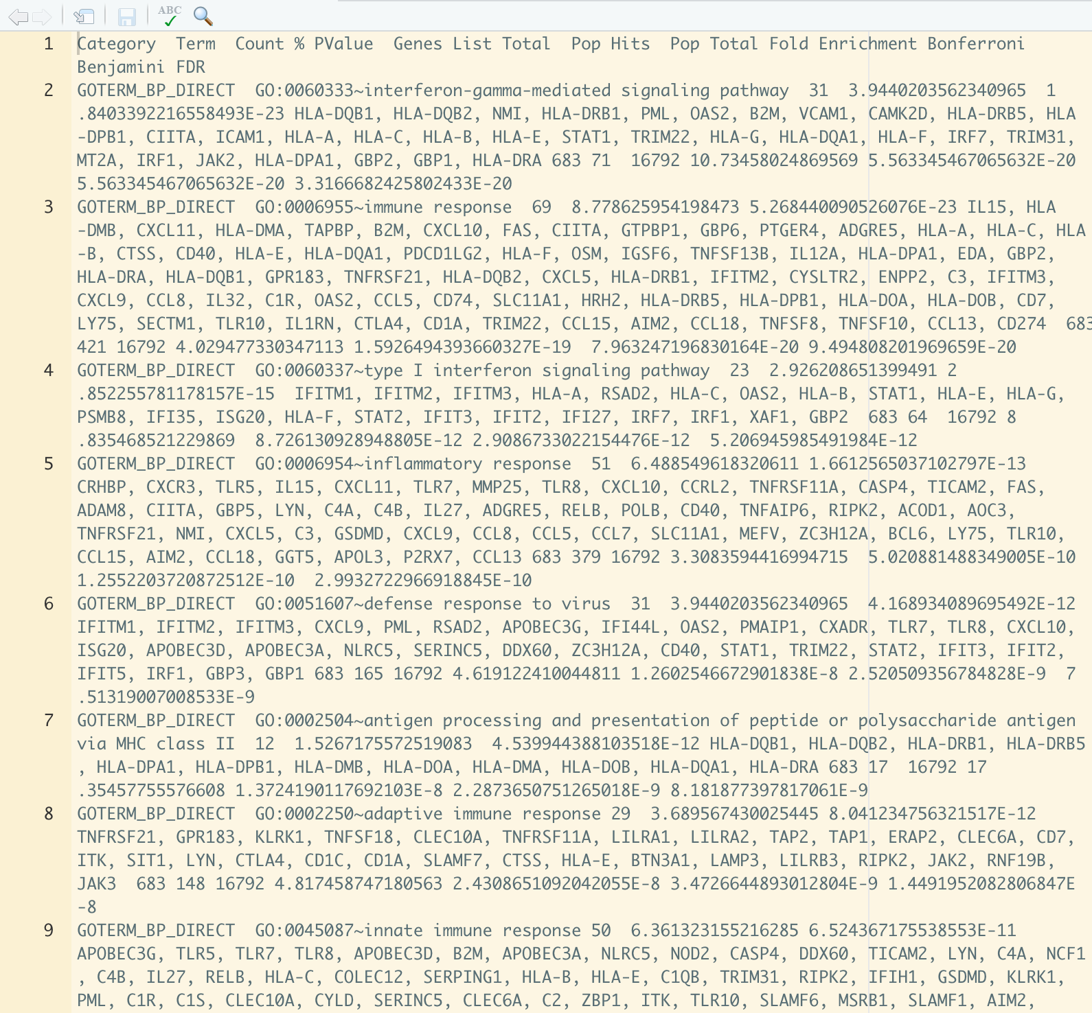
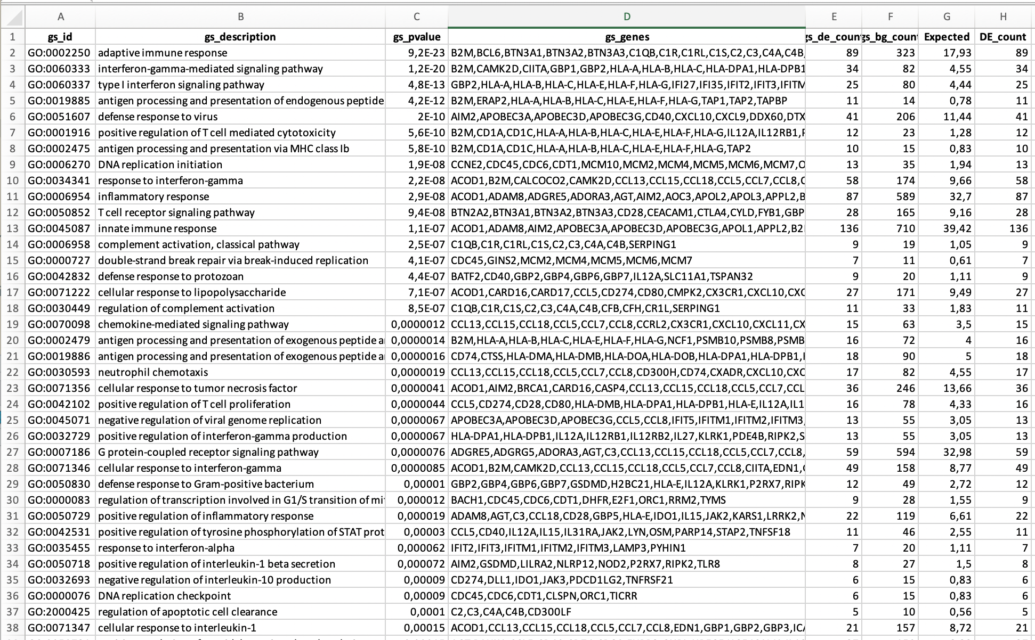
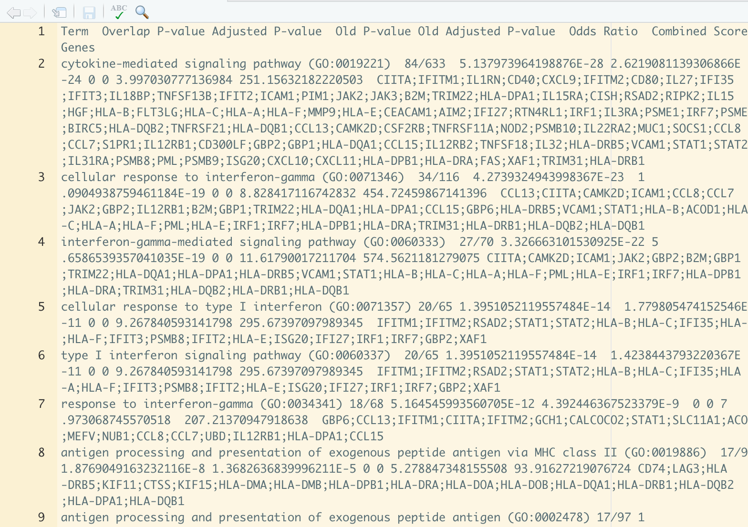
Been there, done that

Slide 6
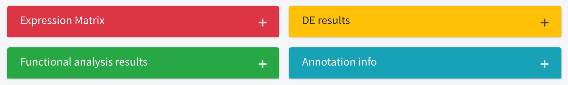
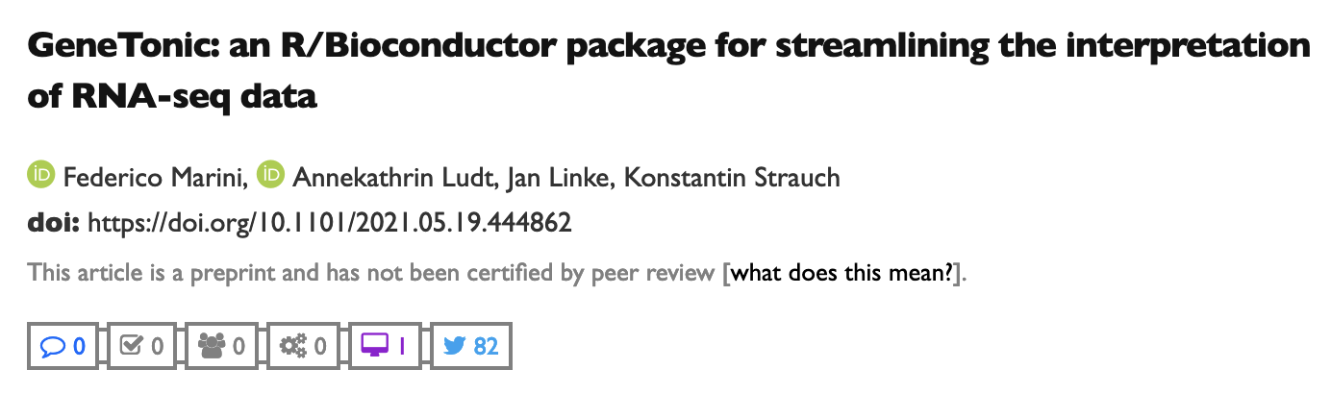
GeneTonic - from the manuscript
“We developed the GeneTonic software package, which serves as a comprehensive toolkit for streamlining the interpretation of functional enrichment analyses, by fully leveraging the information of expression values in a differential expression context.”
https://doi.org/10.1101/2021.05.19.444862

Slide 7
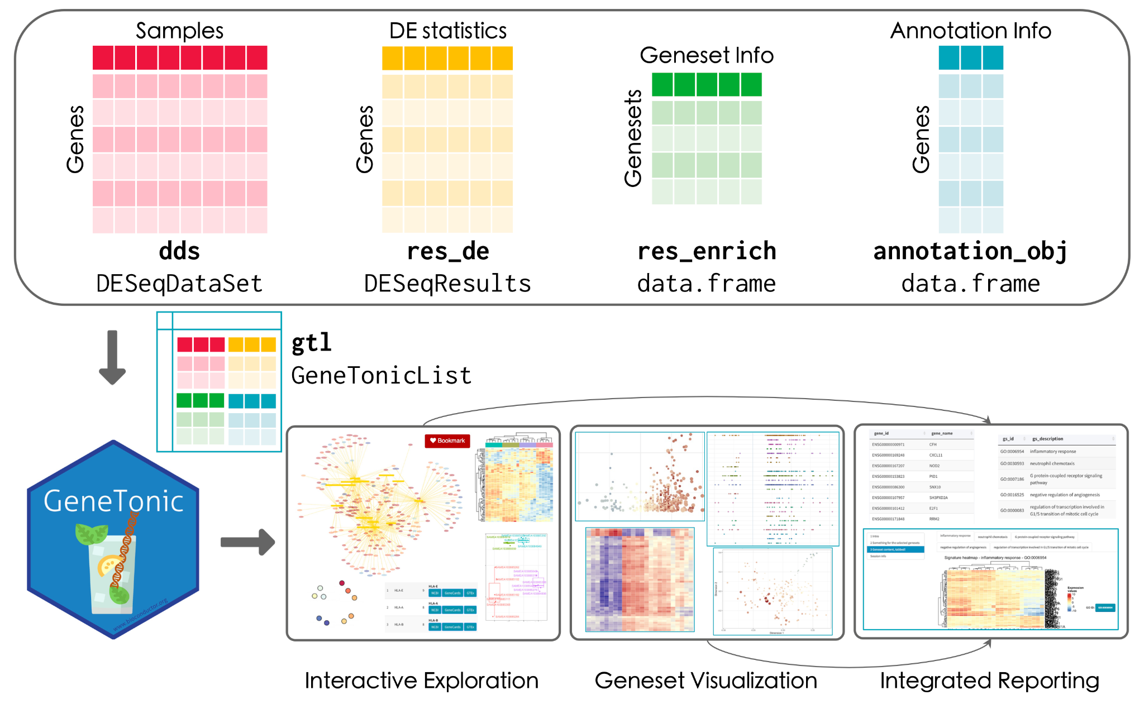
The GeneTonic workflow
https://doi.org/10.1101/2021.05.19.444862

Slide 8


GeneTonic in a nutshell
Uses standardized objects for your datasets and results (Excel does not count) - one-stop-shop solution after commonly done steps!
Visual overviews on the enrichment results + expression data
Interactivity and drilldown operations to make analyses accessible
Reducing time-to-insight for collaboration partners - getting better results, together
Interoperability as key design aspect
Bookmarkinging and reporting for reproducibility

Slide 9
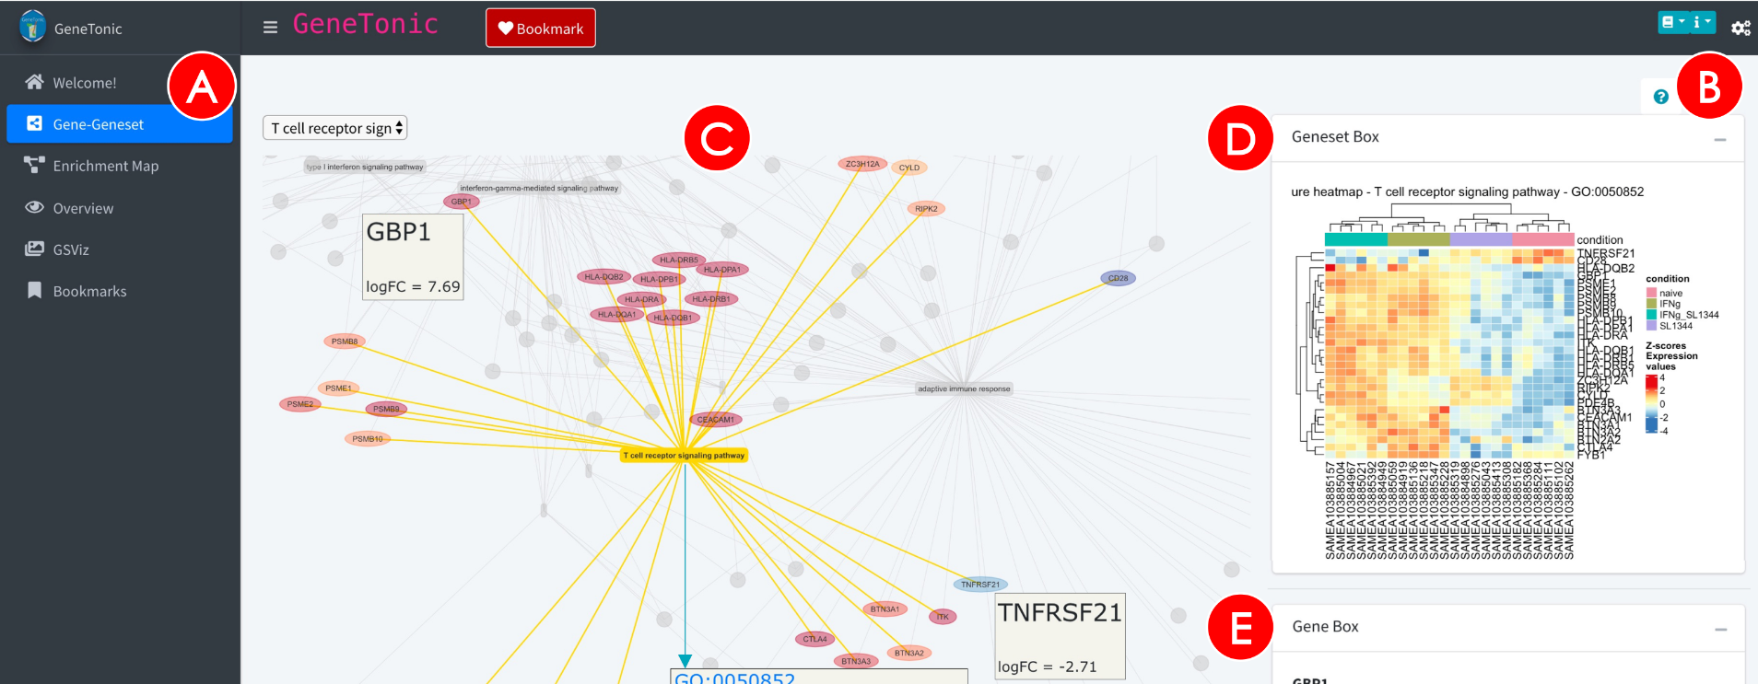
“I’ll have a look around” - the tour setup
GeneTonic will suggest what you can do in each section

Slide 10
Links and material
http://bioconductor.org/packages/GeneTonic/
https://github.com/federicomarini/GeneTonic
http://shiny.imbei.uni-mainz.de:3838/GeneTonic/
Manuscript: https://doi.org/10.1101/2021.05.19.444862, in press BMC Bioinformatics
Reach out for suggestions & contributions!

